Slide 1
Super Agent Portal for TA (Travel Agent)

Slide 2
Points to be Covered
Self Onboarding Process
Super agent portal Login
Booking process
Bulk Booking Process
Bulk Booking Price Negotiation
Booking Modification Via Yo Chat
Wallet
Business Summary
Help
Q&A

Slide 3
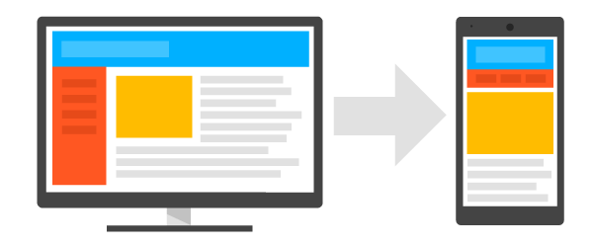
OYO SuperAgent – Key Tenets
1
2
3
Accessibility and Control:
Book hotels from your Desktop or on the go
Ability to modify booking on your own.
Transparency and Trust:
Complete access to booking statuses, business summary and commission payouts
Commercial Proposition:
Earn Money: Upsell and flat commission basis, Invoicing

Slide 4
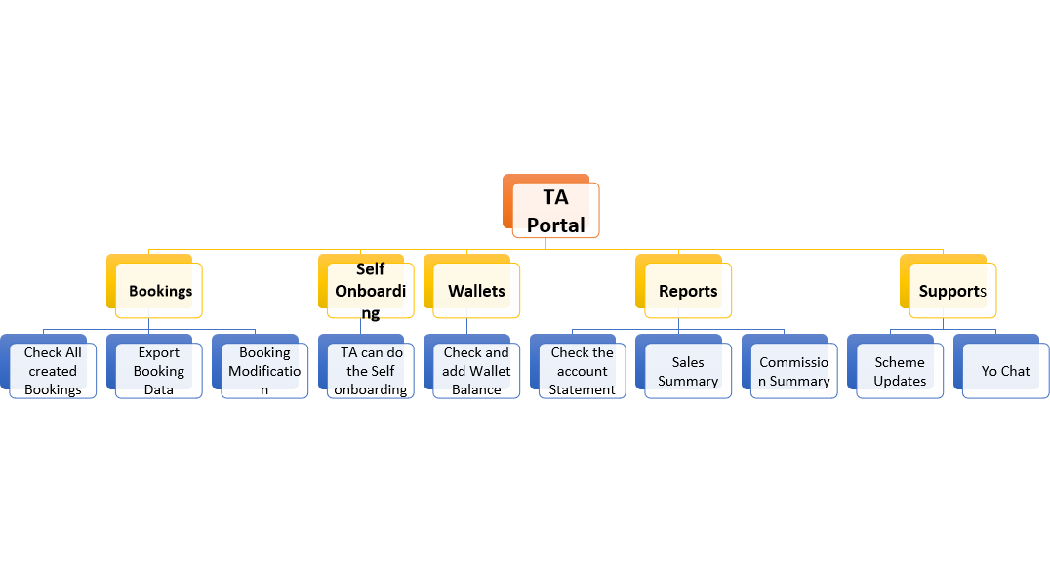
Features of TA Portal

Slide 5
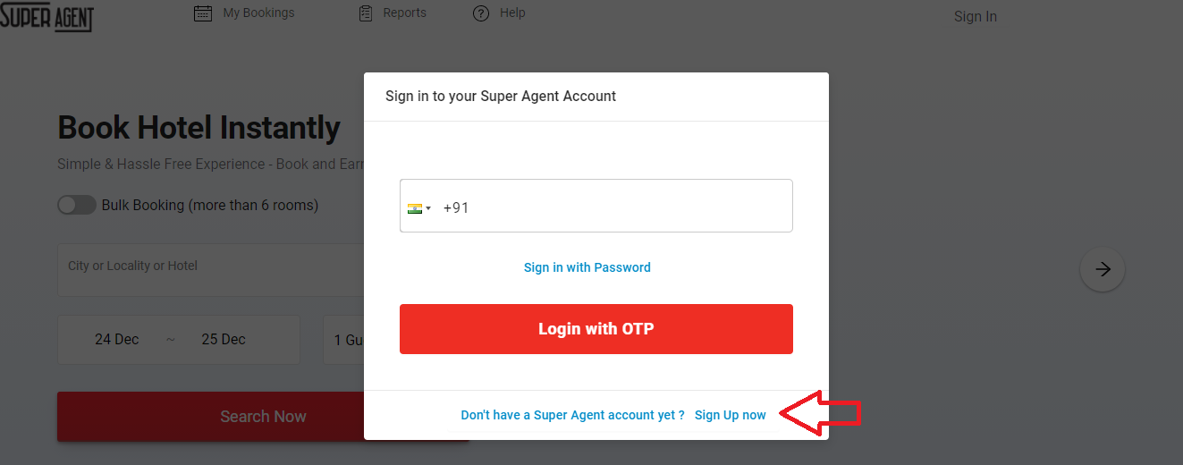
Process For Self Onboarding through Super Agent
Open Super Agent home page (https://travelagent.oyorooms.com/superAgent/home)
Click on *Sign Up Now*

Slide 6
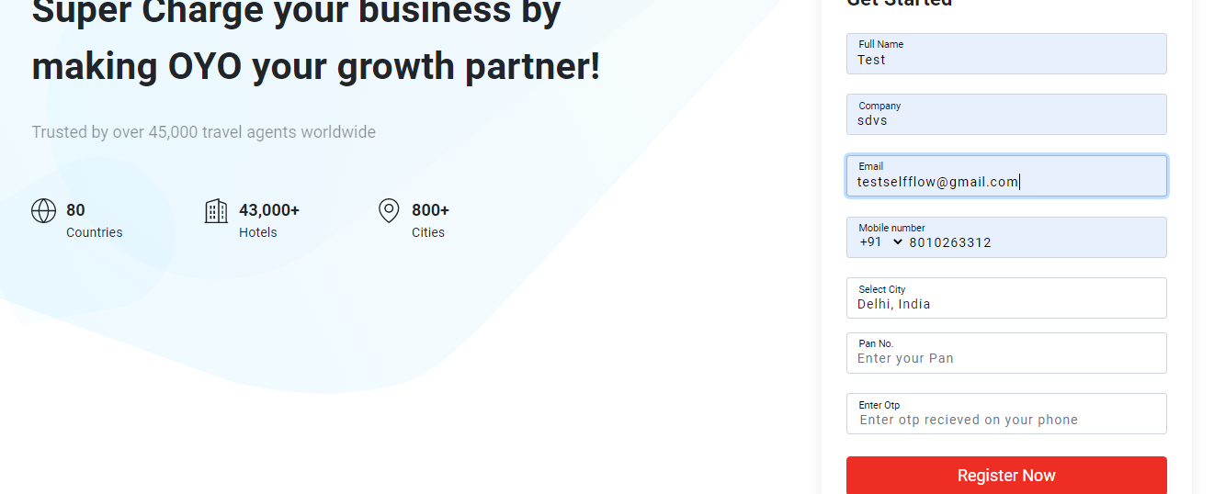
Process For Self Onboarding through Super Agent
Enter all details I.e Full Name, Company Name, Email Id,City and Mobile number
Click on *Register Now*
Enter PAN Card number and OTP then Click on *Register Now*

Slide 7
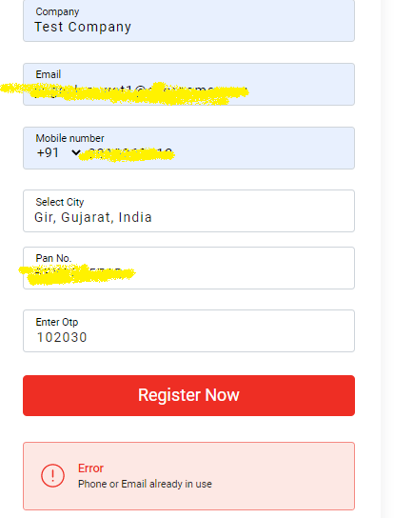
Process For Self Onboarding
Note : In case partner received *Phone and Email already in use* error. It’s mean they already registered with OYO.
They can do login with OTP from Login page

Slide 8
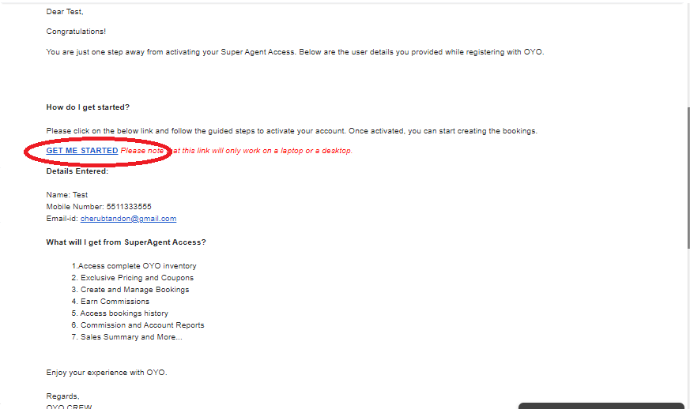
Next steps post onboarding the account
Admin will receive the email from noreply@oyorooms.com with the subject line *Welcome to OYO!*
Click on *GET ME STARTED* and complete the account verification process

Slide 9
Next steps post onboarding the account
Click on *Send OTP*
Enter OTP and click on *Verify Mobile*

Slide 10
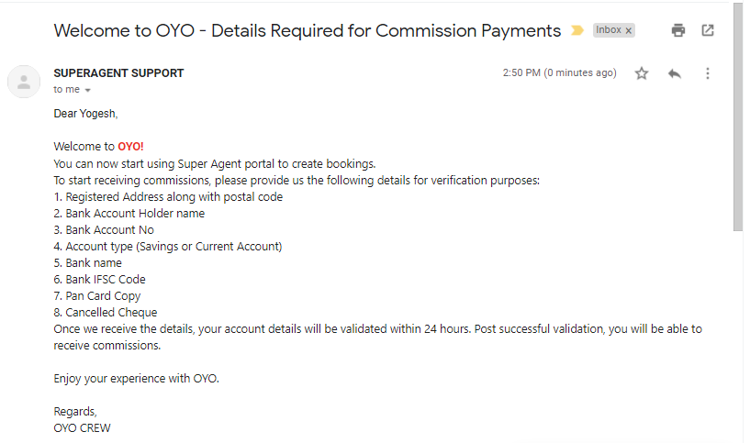
The steps to Earn Commission
After successful onboarding, the account Admin will receive the Email through superagent.support@oyorooms.com
Admin has to share all mandatory details on the same email I.e Bank Account Details, PAN card Copy, Cancel cheque etc

Slide 11
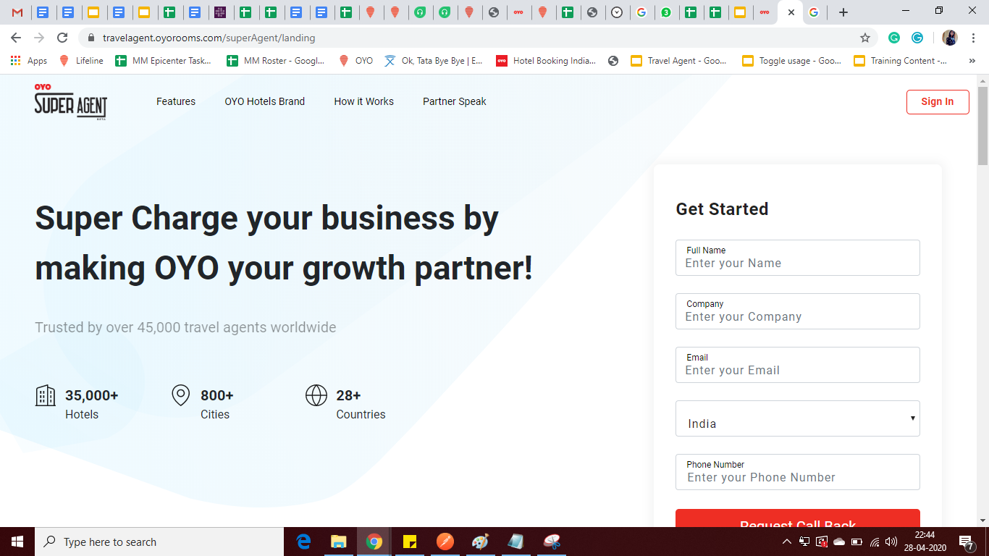
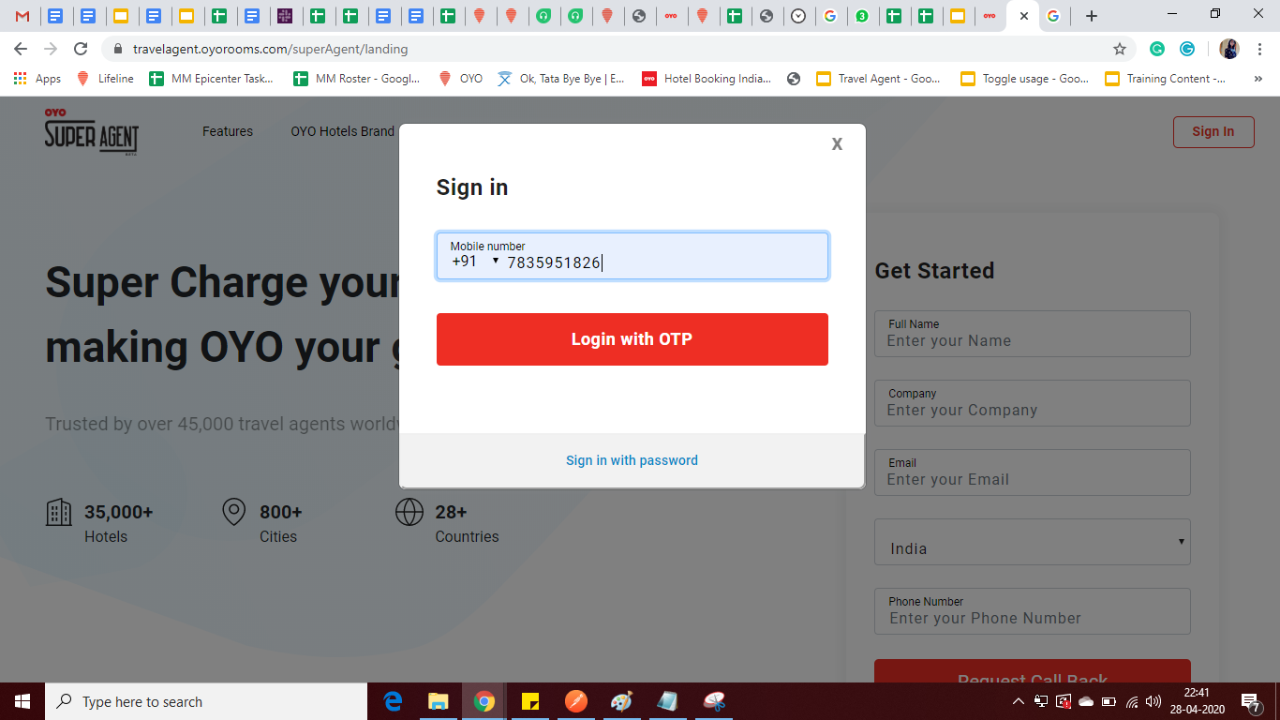
Login to TA Portal
User can login with registered mobile number and password or can do login with OTP.
URL is https://travelagent.oyorooms.com/
Click on Sign In and enter the number.

Slide 12
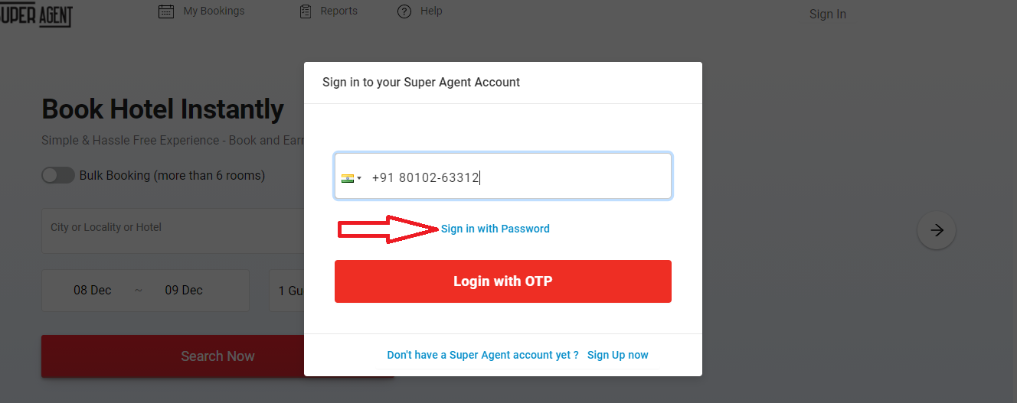
How to reset password?
Open Super Agent Portal (https://travelagent.oyorooms.com/superAgent/home)
Input your 10 digit mobile phone number
Click on *Sign in with Password*

Slide 13
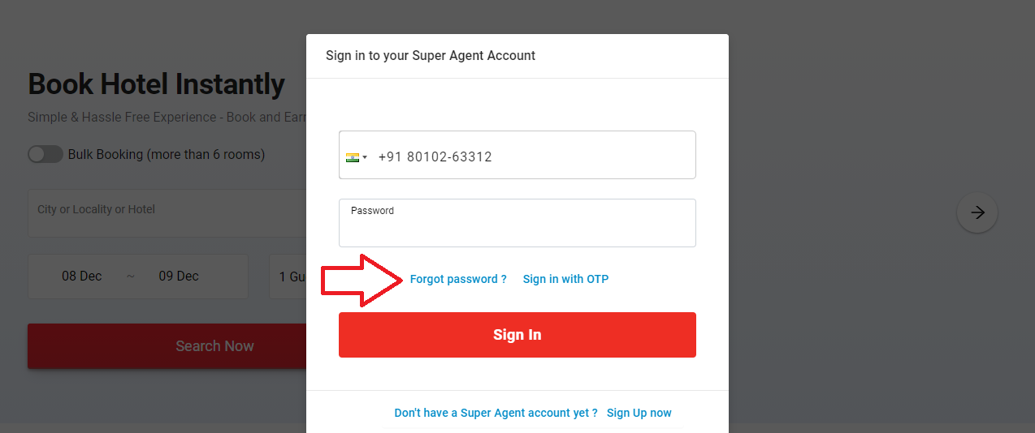
How to reset password?(Cont.)
Click On *Forget Password*

Slide 14
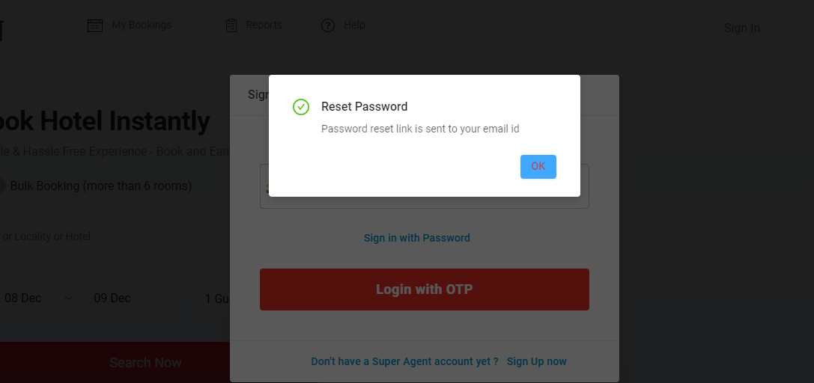
How to reset password?(Cont.)
Click on *Change my Password*
Admin will get reset password link via Email

Slide 15
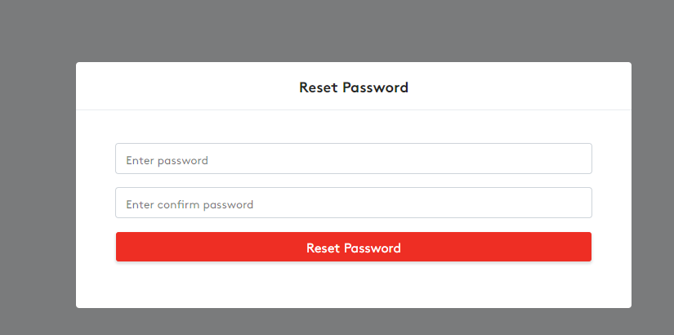
How to reset password?(Cont.)
Enter new password and Confirm Password

Slide 16
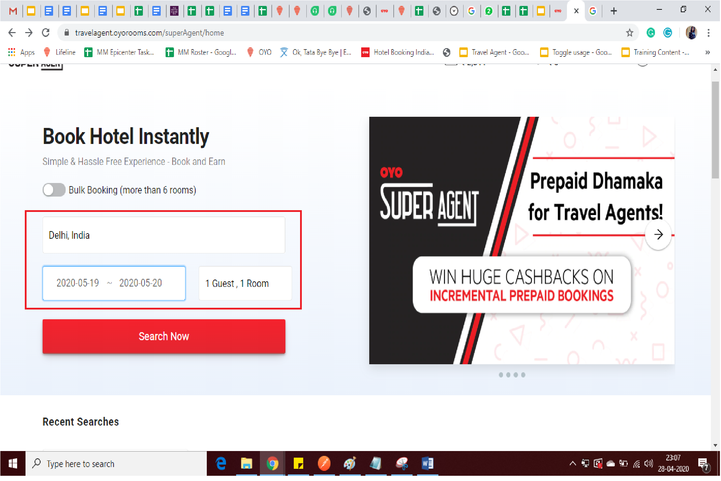
Booking Creation Flow
Search for Hotel/Location
Select the check-in/check out date
Select the no. of room/guest
Click on Search Now

Slide 17
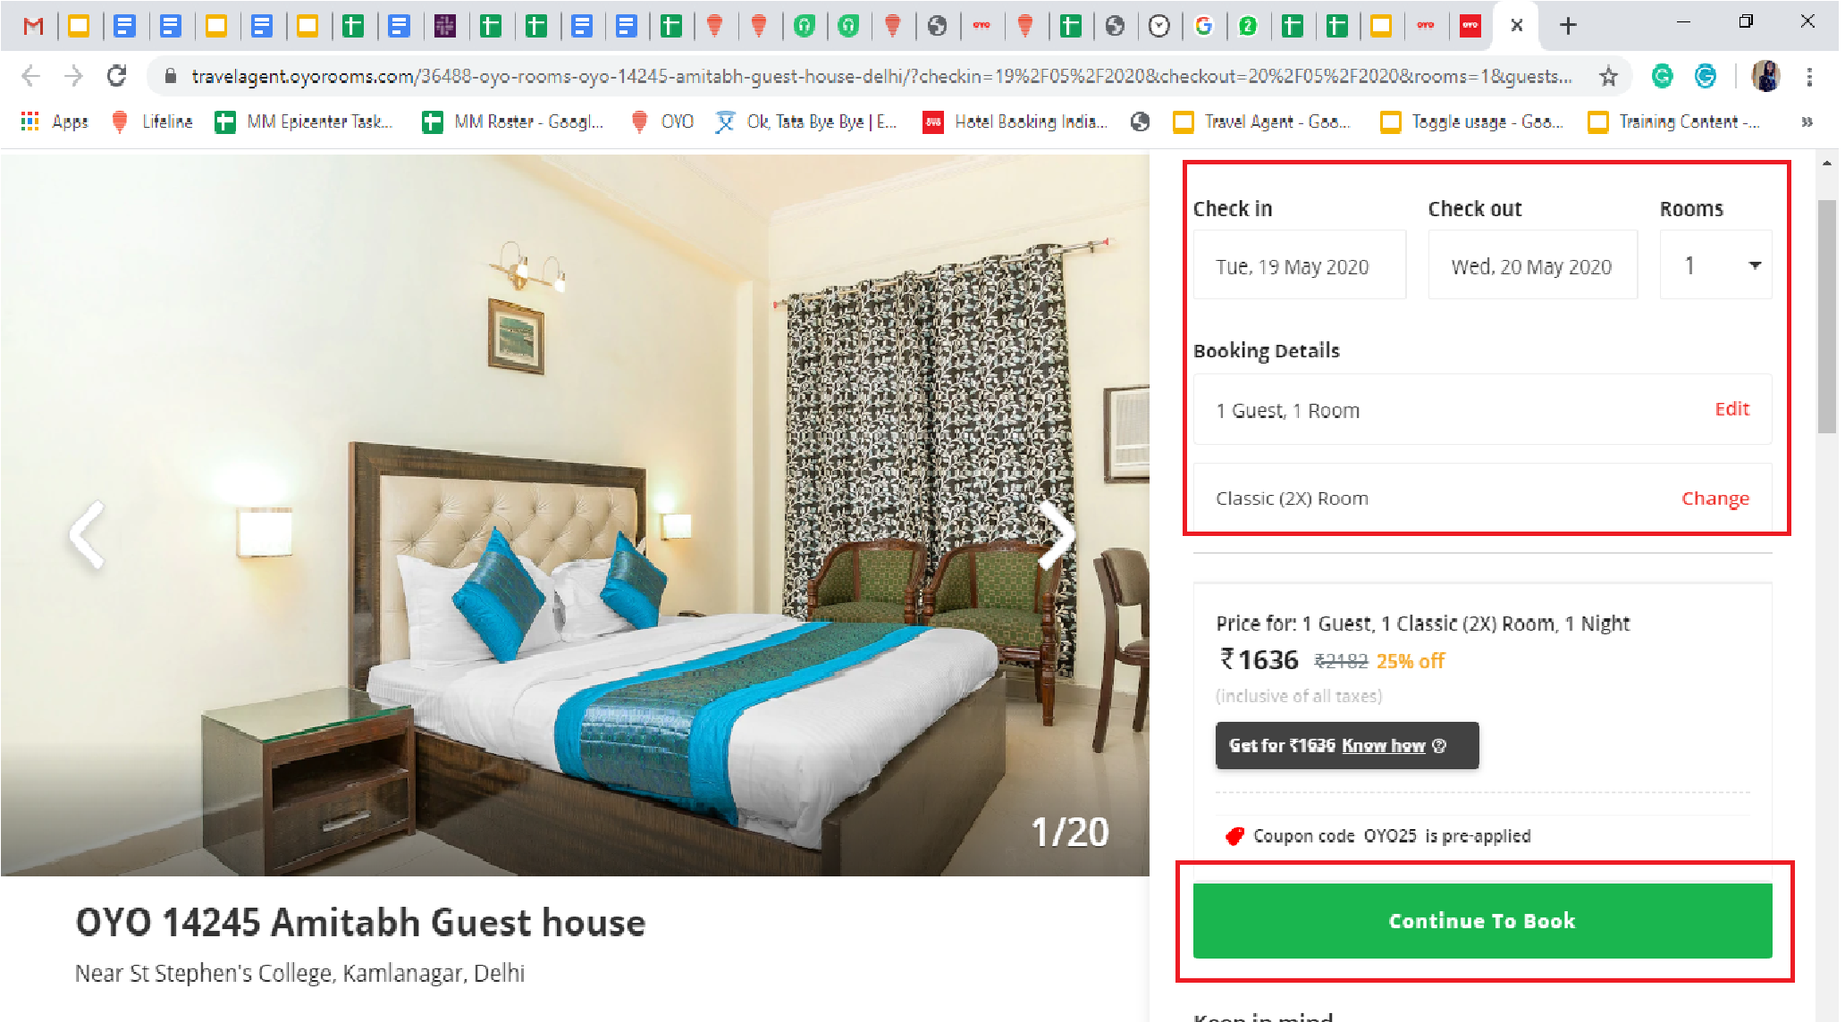
Booking Creation Flow (Cont.)
Cross check the details that filled earlier or can change here if required.
Click on Continue to Book button

Slide 18
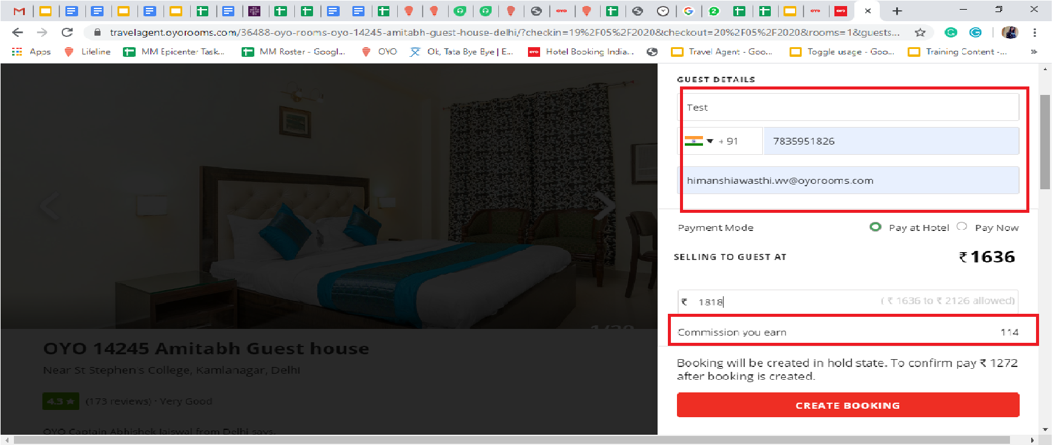
Booking Creation Flow (Cont.)
Enter the guest details i.e.Name, email id.
Select the payment mode i.e. ‘Pay later’ or ‘Pay Now’
You can upsell the selling price where min and max limit is given.
You can see the earn commission against the price and it will pick according the base commission that is updated on lifeline.
Base commission 10
Selling Price:1636
Commission you earn: 114
Click on ‘Create Booking’

Slide 19
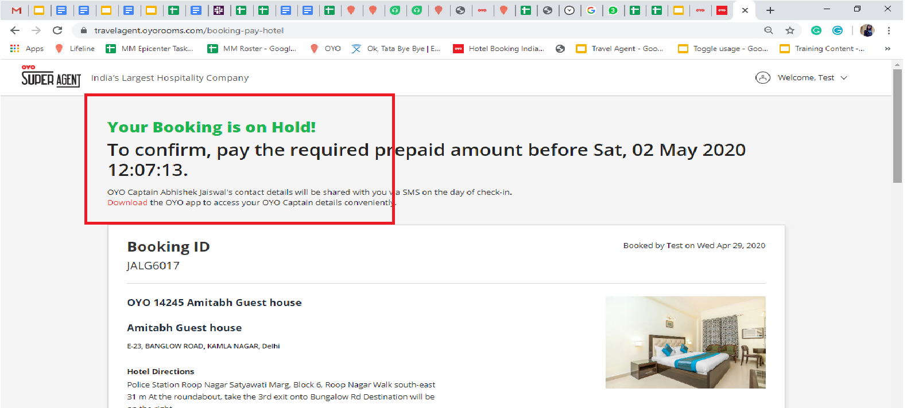
Booking Creation Flow
Booking is on Hold i.e. created in “Saved” status.
After completing the payment process, booking status will automatically change from ‘Saved’ to ‘Confirmed’.

Slide 20
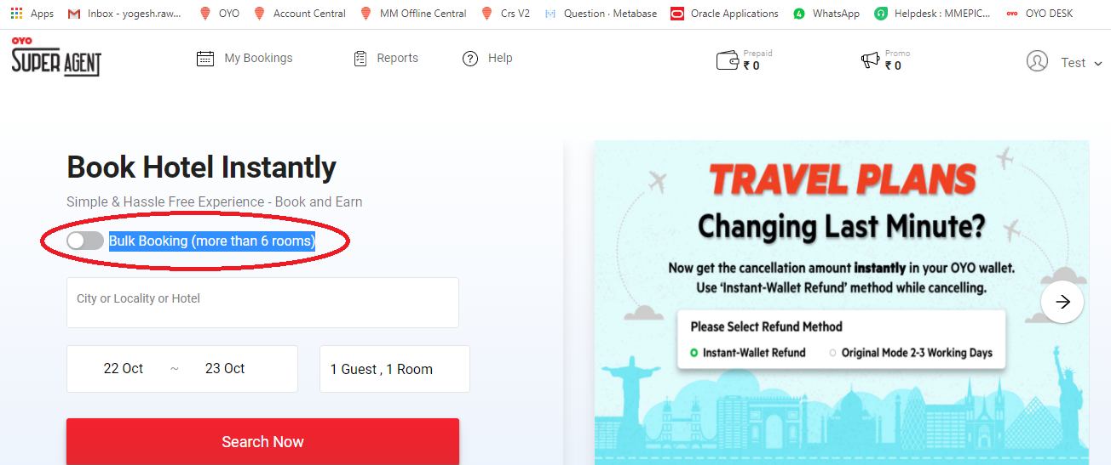
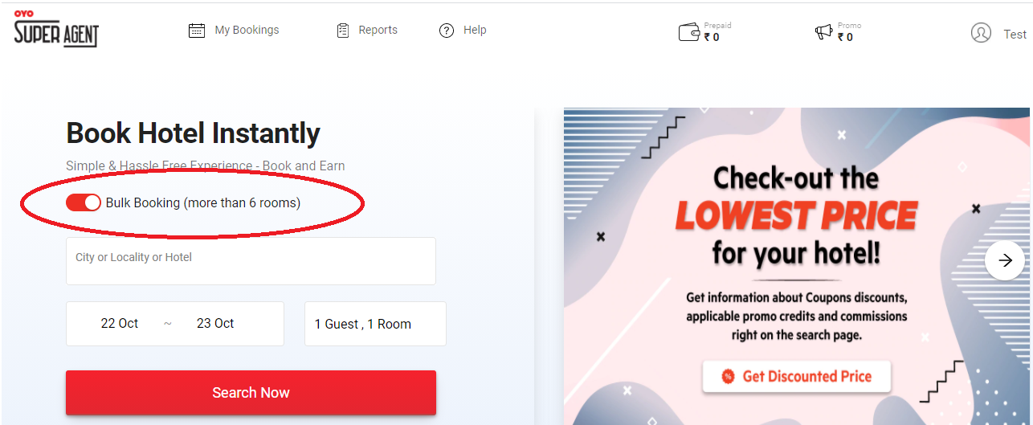
Bulk Bookings through Super Agent Portal
Login with OTP/password on Super Agent Portal
Enable toggle mode *Bulk Booking (more than 6 rooms)* from home page of Super Agent Portal

Slide 21
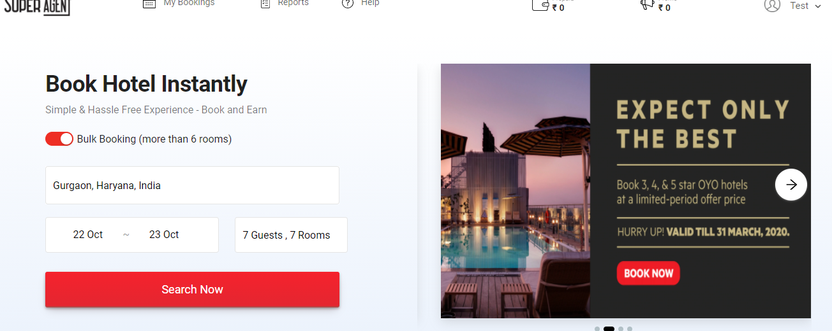
Bulk Bookings through Super Agent Portal
Search Hotel name/City/Locality.
Select Check in/Check out dates.
Select no of rooms and no of guest.
Click on Search button

Slide 22
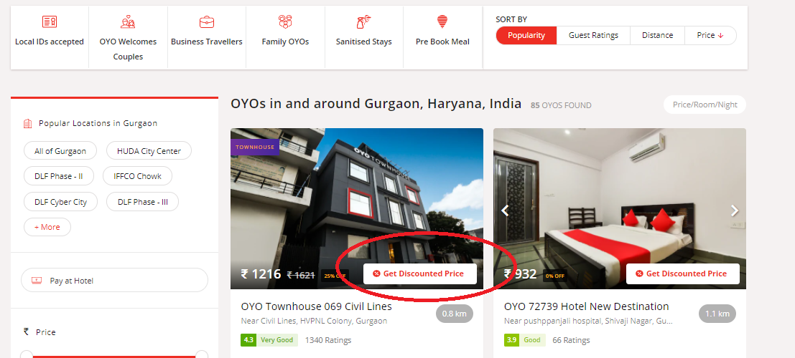
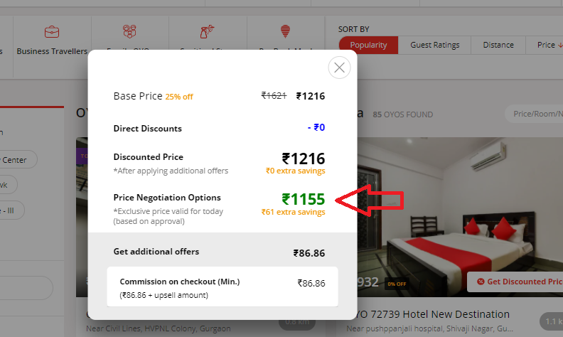
Bulk Booking Price Negotiation Flow
All hotels will reflect on the search page. For best-discounted prices just click on *Get Discounted Prices*

Slide 23
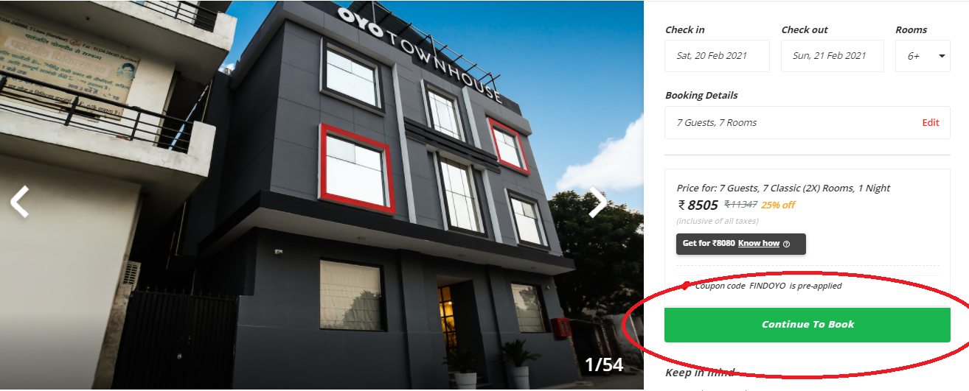
Bulk Booking Price Negotiation Flow
Click on hotel and process to Continue to book on the Hotel detail page

Slide 24
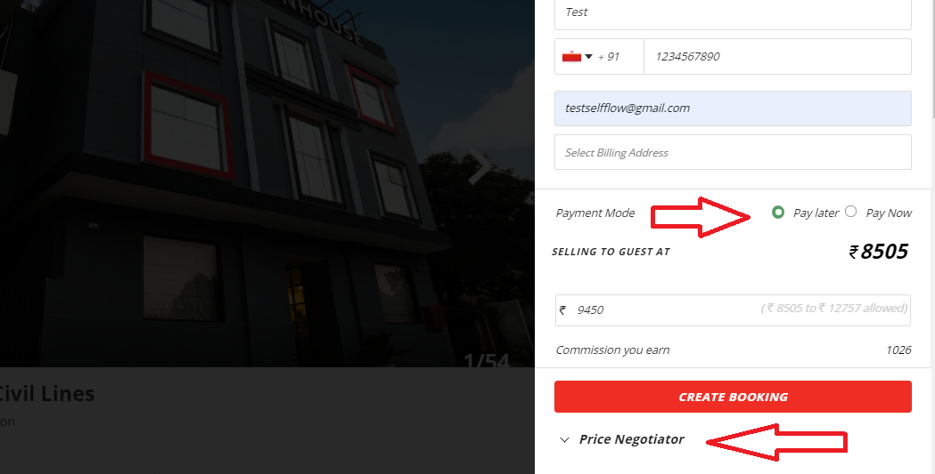
Bulk Booking Price Negotiation Flow
Click On *Pay Later*
Fill all details I.e Guest Name, Email Id and Mobile Number
Then Click on Price Negotiator

Slide 25
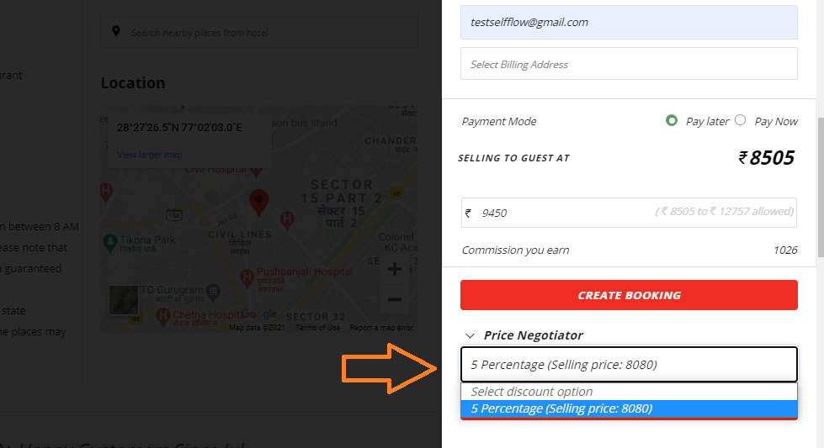
Bulk Booking Price Negotiation Flow
Click on the drop-down in *Price Negotiator*

Slide 26
Bulk Booking Price Negotiation Flow

Slide 27
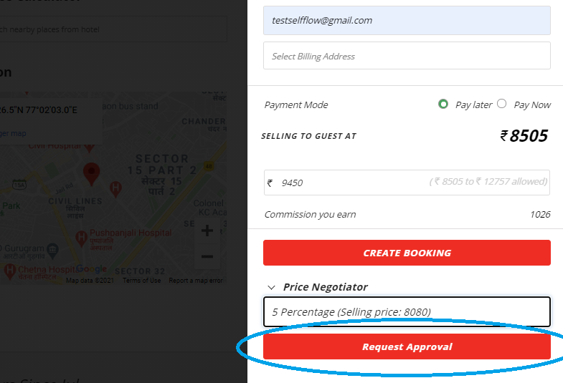
Bulk Booking Price Negotiation Flow
Click On Request Approval
Click on *Confirm*
It will get the confirmed or cancelled basis of approval on negotiated prices. Please wait for 24 hours

Slide 28
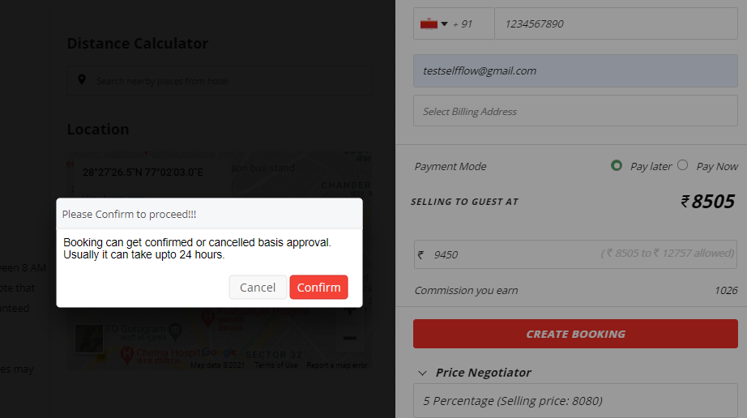
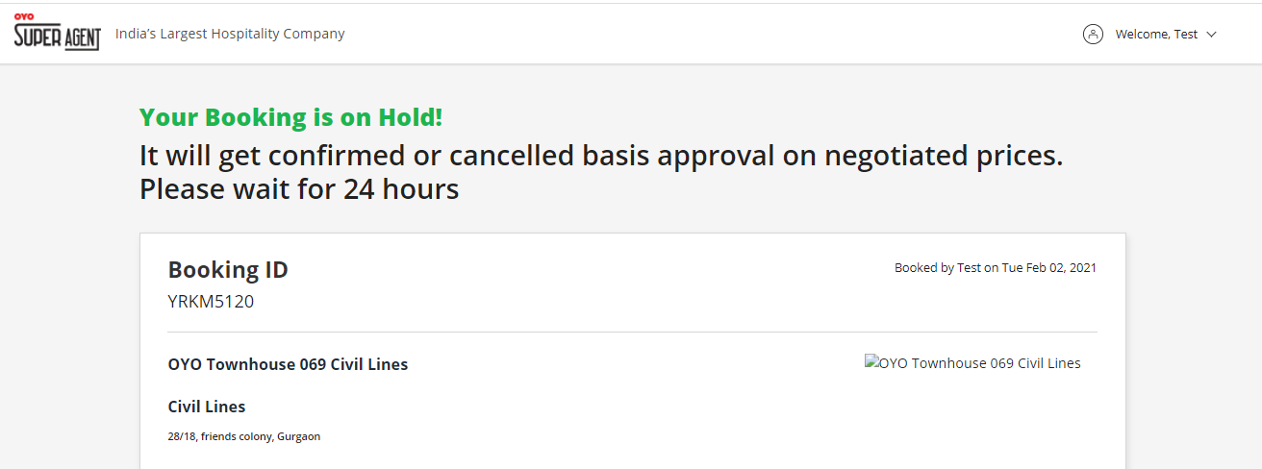
Bulk Booking Price Negotiation Flow
Click on *Confirm*
It will get the confirmed or cancelled basis of approval on negotiated prices. Please wait for 24 hours

Slide 29
Booking Modification Via Yo Chat

Slide 30
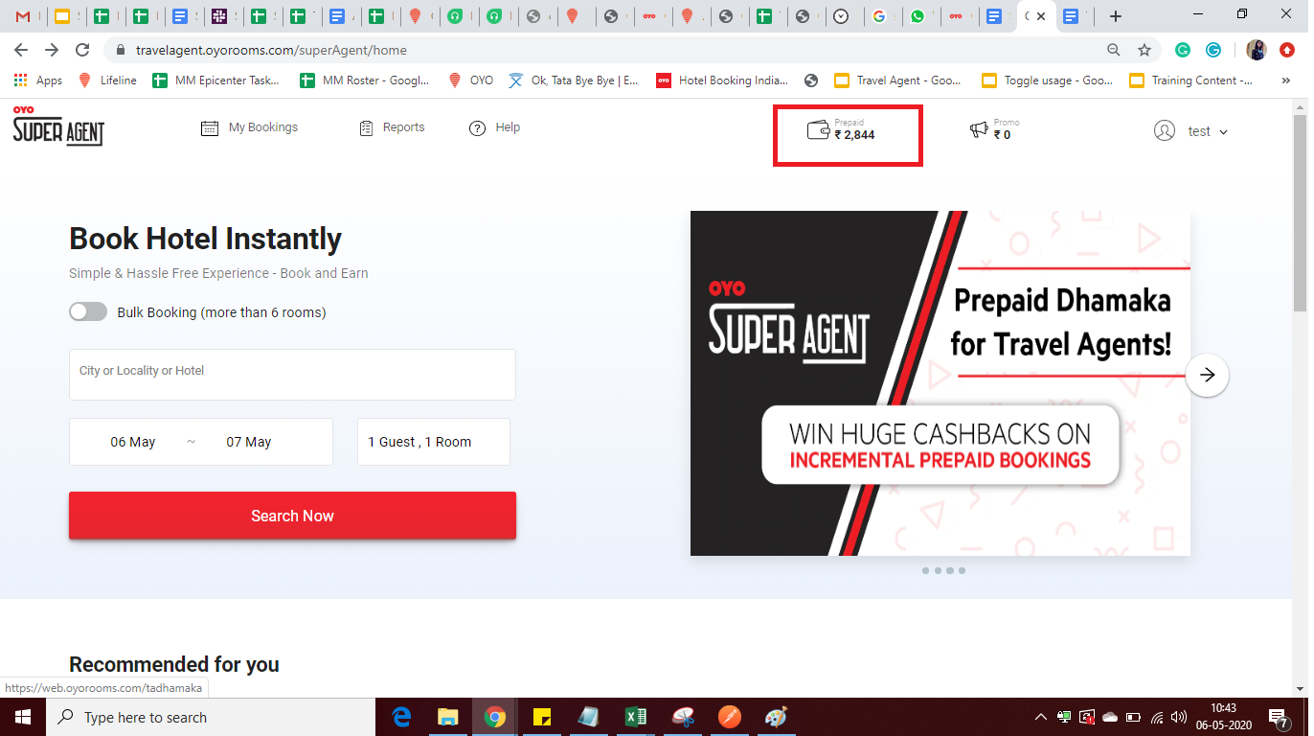
How to load PREPAID_WALLET?
Login to TA portal.
Click on prepaid option that will be visible top of the page.

Slide 31
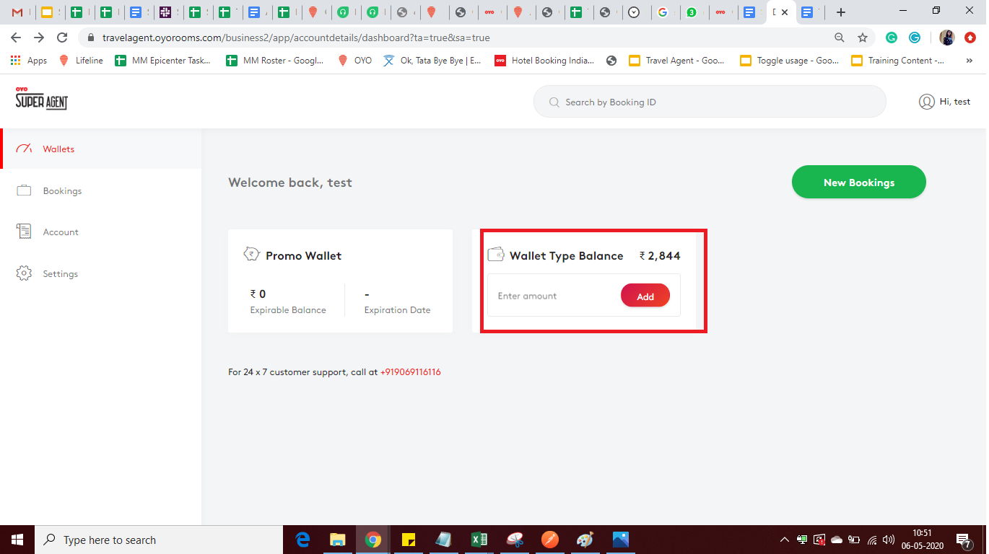
How to load PREPAID_WALLET? (Cont.)
After clicking on prepaid option you will directs to this page.
Go to wallet Type Balance and enter the amount that you want to add and click on ‘Add’ Button.

Slide 32
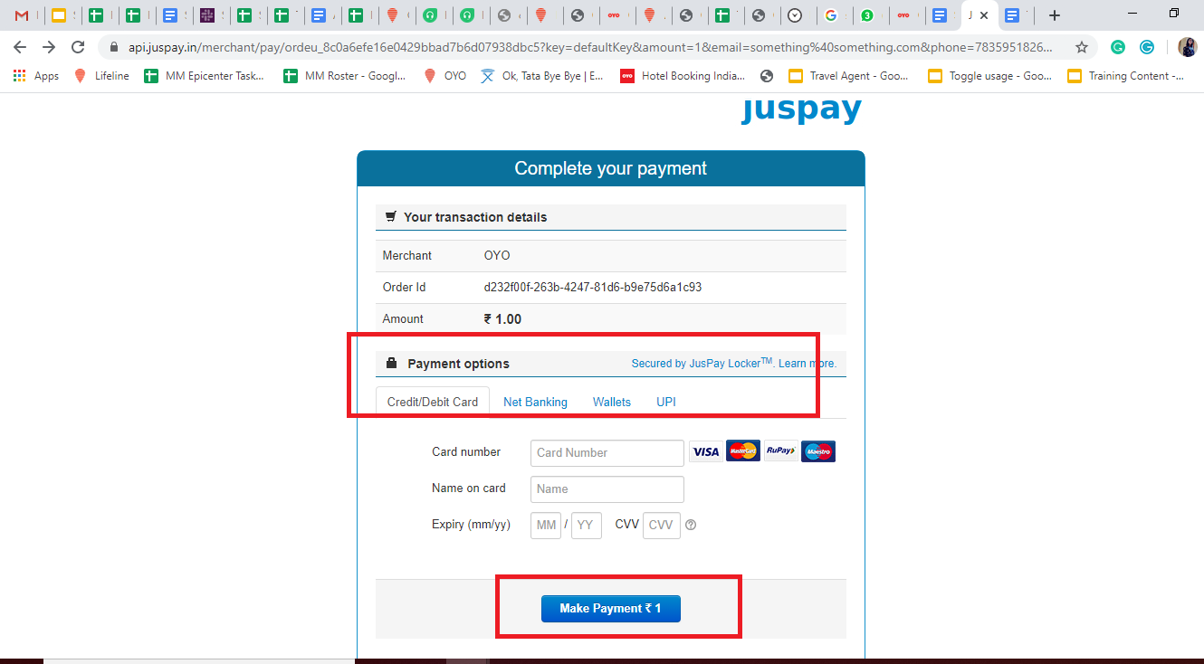
How to load PREPAID_WALLET?
After clicking on the ‘Add’ button you will get another page for selecting the payment options i.e Credit/Debit cards/Netbanking/wallets/UPI
Click on Make Payment

Slide 33
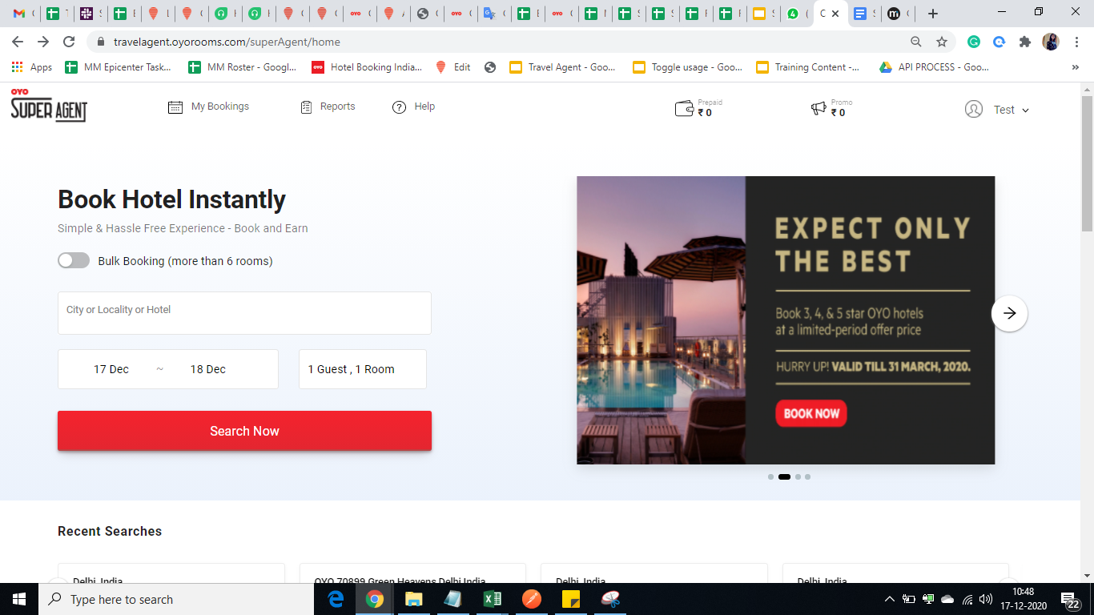
How to check all sales summary through the portal?
Go to Reports

Slide 34
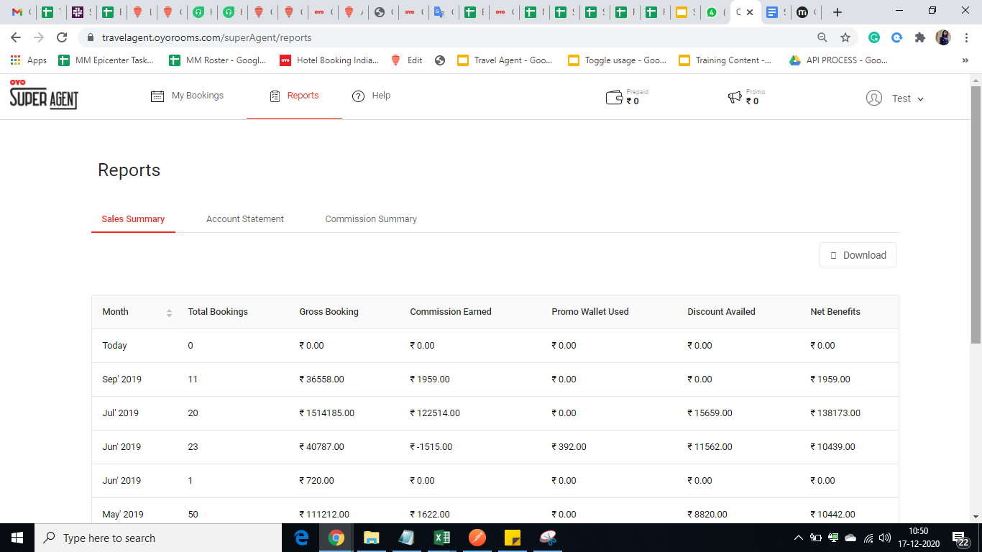
How to check all sales summary through the portal?(Cont.)
Click on ‘Sales Summary’,’Account statement’, ‘Commission Summary’ option
After clicking on the sales summary, Account statement,Commission Summary you will be able see the details as well as download it through the ‘Download’ option.

Slide 35
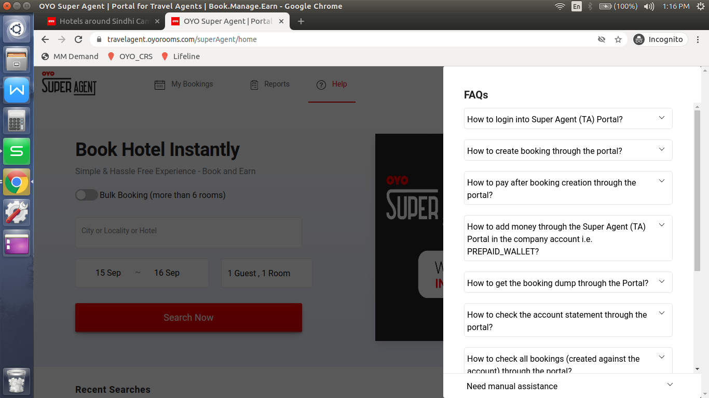
Help - FAQs
Go to Dashboard Page.
Click on ‘Help’.
List of FAQs will appear.
For every question there is a step by step solution available.

Slide 36
THANK YOU
ANY QUESTIONS

